Slide 1

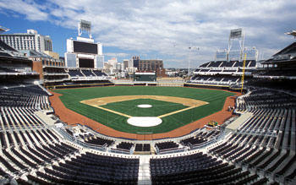
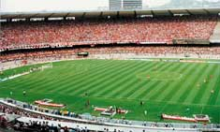
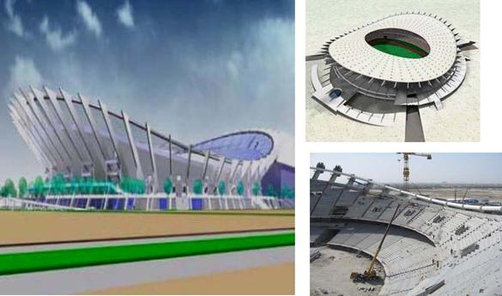
Top Sports Field Worldwide

Slide 2
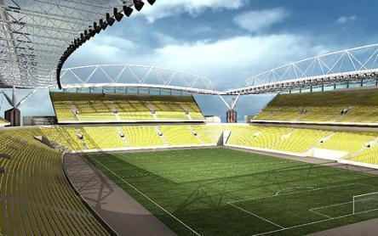
Peter Mokaba Stadium
Polokwane, SOUTH AFRICA
Host the 2010 FIFA World Cup
Hunter Products: ICC, PGV, I-25, MP Rotator

Slide 3
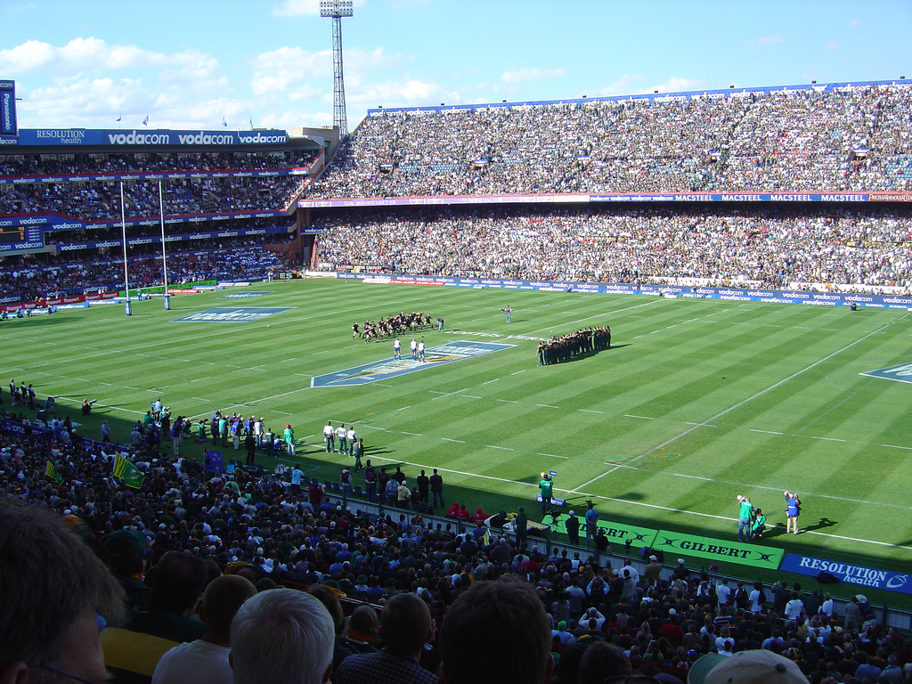
Loftus Staduim
Pretoria, SOUTH AFRICA
Host the 2010 FIFA World Cup
Hunter products used: ICC, PGV, I-25

Slide 4
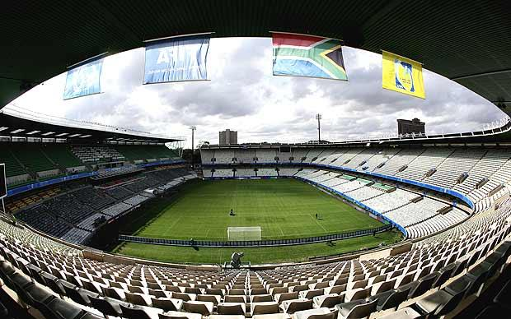
Free State staduim
Bloemfontein, SOUTH AFRICA
Host the 2010 FIFA World Cup
Hunter Products: ICC, PGV, I-25

Slide 5
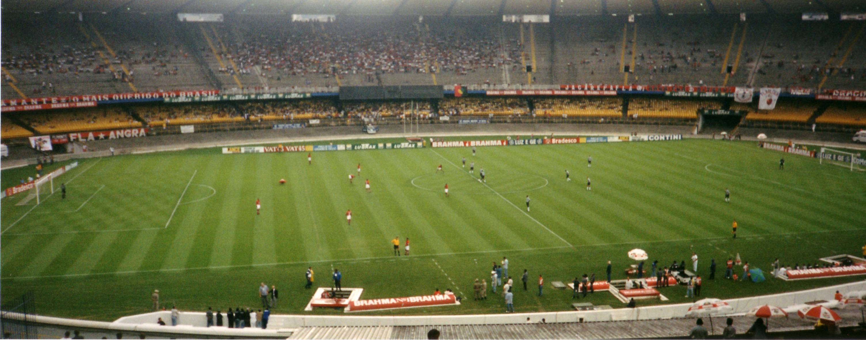
Maracana Stadium
Rio de Janeiro, BRAZIL
Will host the 2014 World Cup Final and the 2016 Summer Olympics!
Hunter Products: I-31, ICV

Slide 6
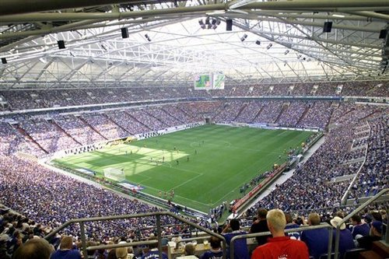
Malines Stadium
Mechelen, BELGIUM
The home ground for the KV Melchen of the Belgium Football Club

Slide 7
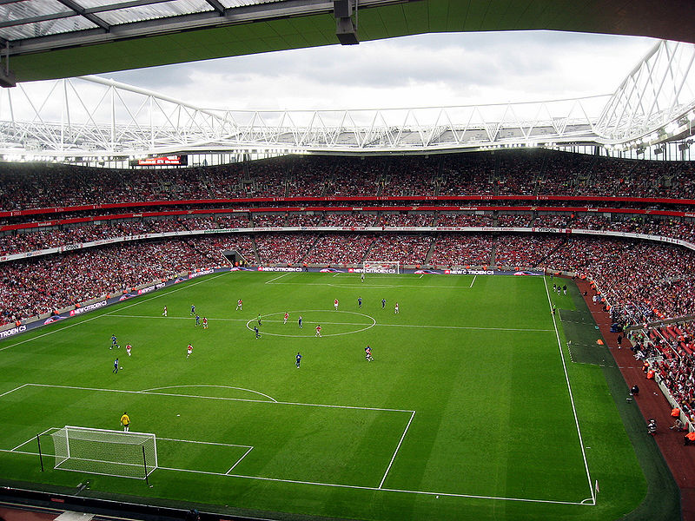
Emirates Stadium
London, ENGLAND
Formerly Ashburton Grove, is a football stadium located in Holloway in the London Borough of Islington and is the current home of Arsenal Football Club

Slide 8
Jaber Al-Ahmad
International Stadium
Safat, KUWAIT
The largest soccer and Olympic-standard sports venue in Kuwait

Slide 9
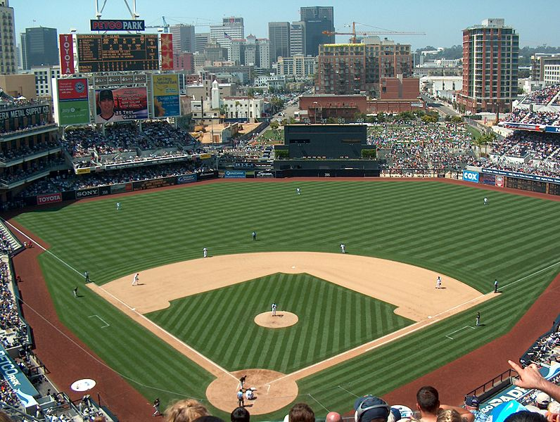
Petco Park
San Diego, USA
The home park of Major League Baseball's San Diego Padres

Slide 10
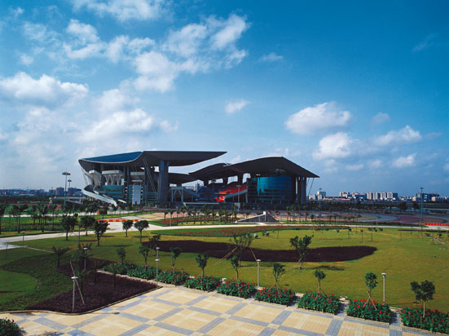
Guangzhou Olympic Center
Guangzhou, CHINA
Modern gymnasium which was built mainly for the 9th National Game of China in 2001 by the Guangdong Provincial People's Government, covering an area of 1.01 million square meters.

Slide 11
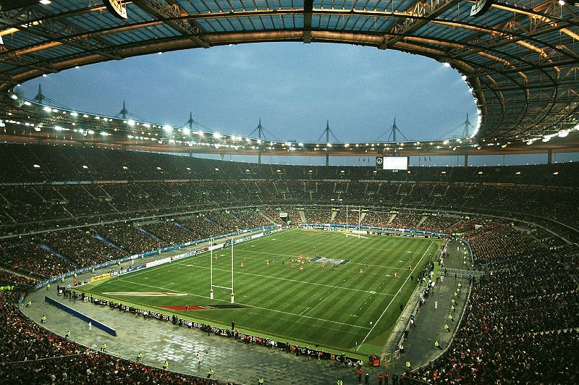
Stade de France
Paris, FRANCE
It is used for the French rugby union team during the Six Nations and other major internationals.

Slide 12
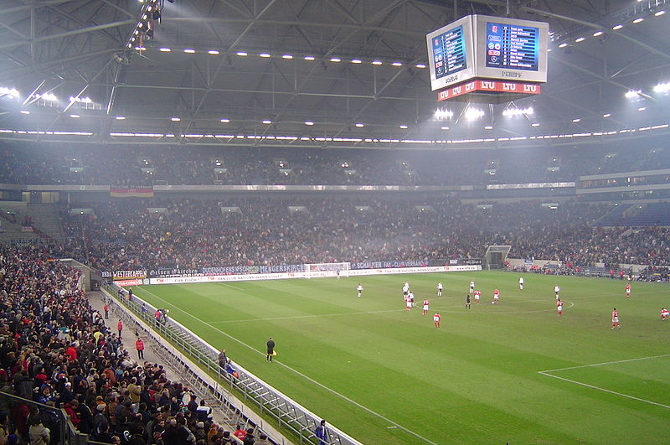
Schalke Arena Stadium
Gelsenkirchen, GERMANY
Hosted the 2004 UEFA Champions League final and 5 matches in the 2006 FIFA World Cup, including a quarter-final

Slide 13
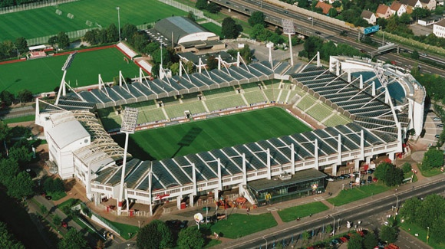
Bayer 04 Leverkusen Stadium
Leverkusen, GERMANY
The home ground for the Bayer 04 Leverkusen, which is a German football club based in Leverkusen, North Rhine-Westphalia.

Slide 14
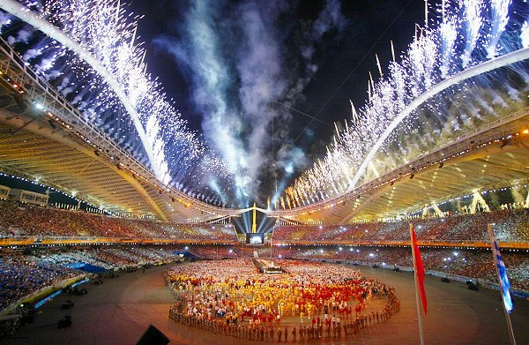
Athens Olympic Stadium
Athens, Greece
it is the major Greek stadium and hosted the athletics events and the football (soccer) final at the 2004 Summer Olympics.

Slide 15
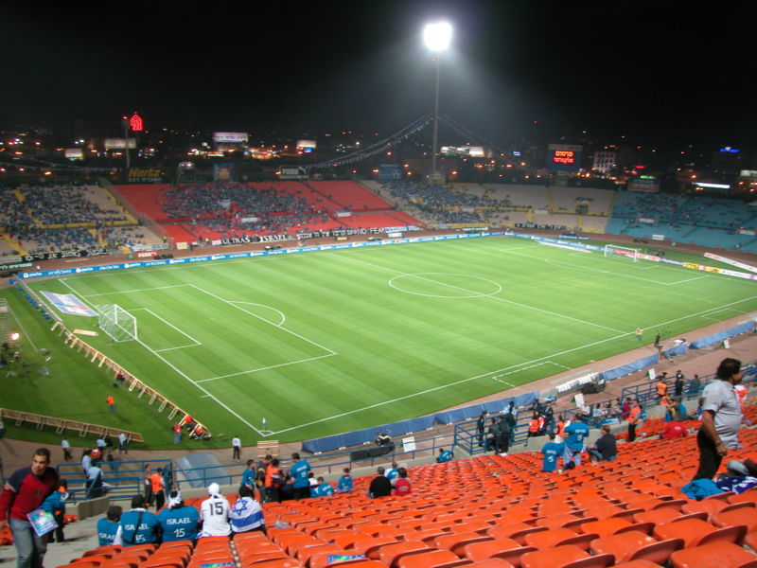
Ramat Gan Stadium
Tel Aviv, ISRAEL
This is the only stadium in Israel which is in a world-class standard, and the only one to host official FIFA World Cup Qualifiers and UEFA Champions League games.

Slide 16
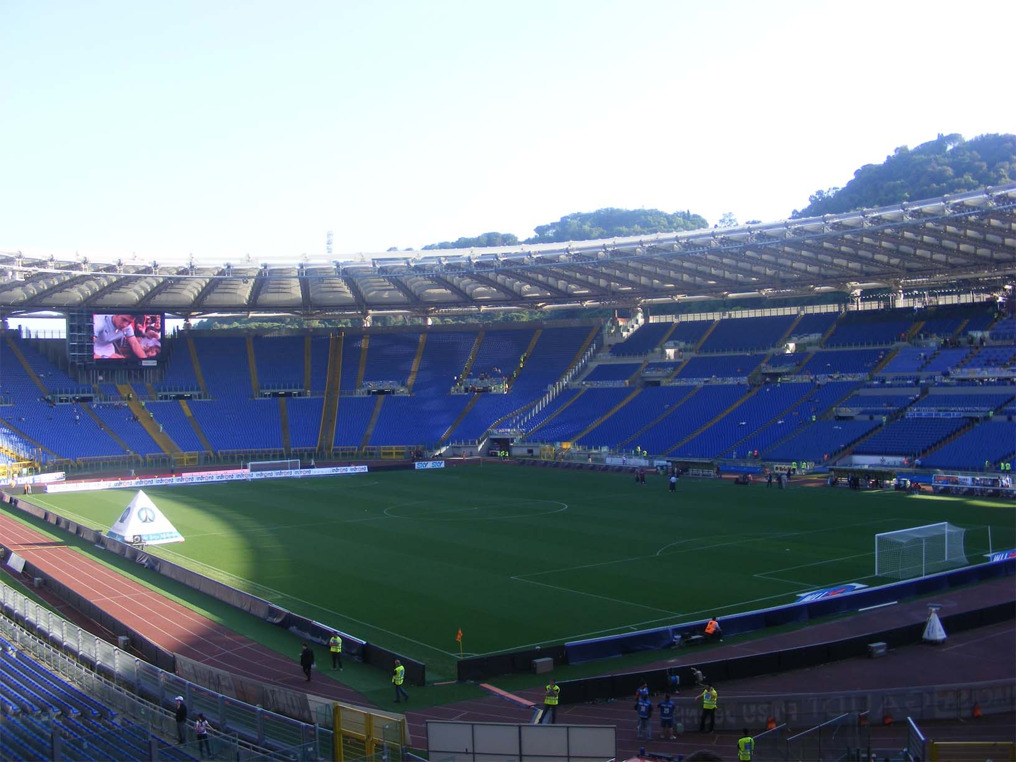
Stadio di Novara
Novara, ITALY
The home ground of Novara Calcio

Slide 17
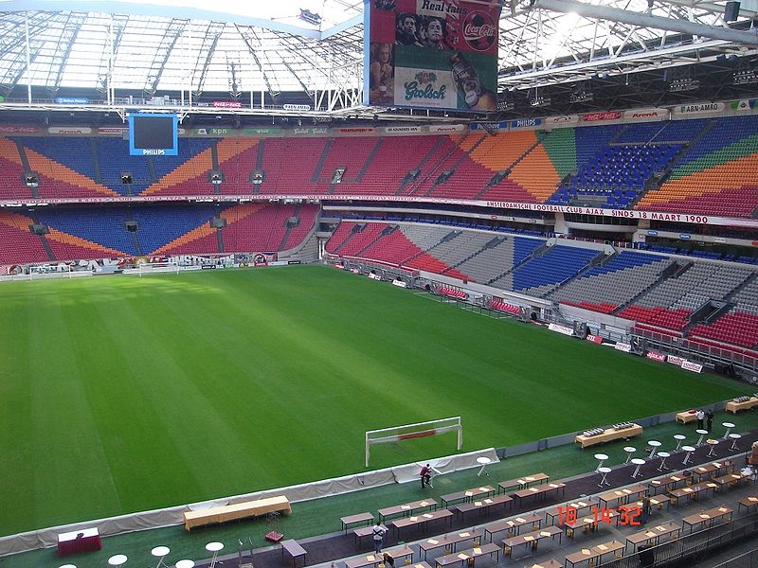
Amsterdam Arena
Amsterdam, Holland
Home of the association football club AFC Ajax.
It was one of the stadiums used during UEFA Euro 2000.

Slide 18
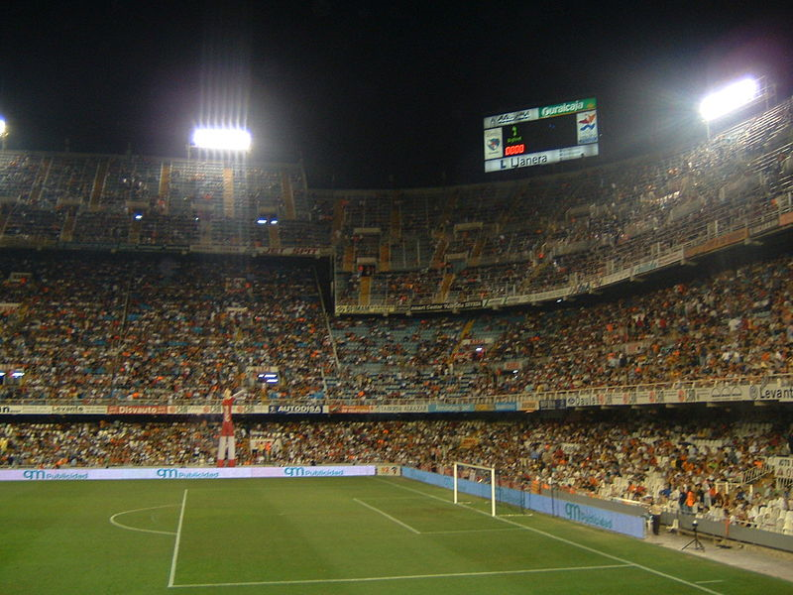
Estadio Mestalla
Valencia, SPAIN
The home ground of Valencia CF

Slide 19
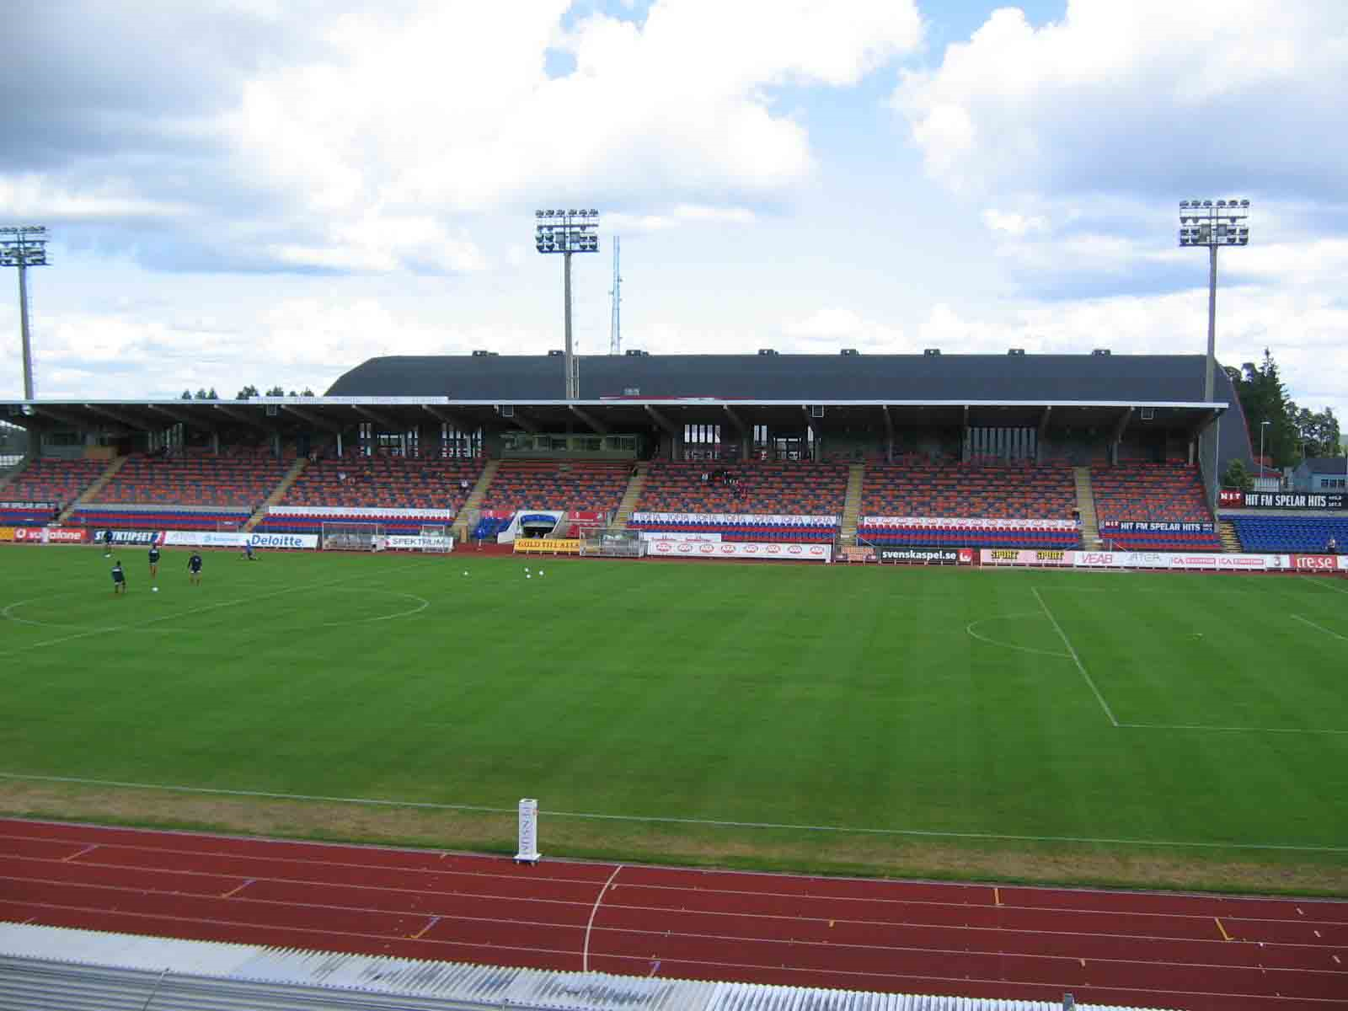
Varendsvallen Stadium
Vaxjo, SWEDEN

Slide 20
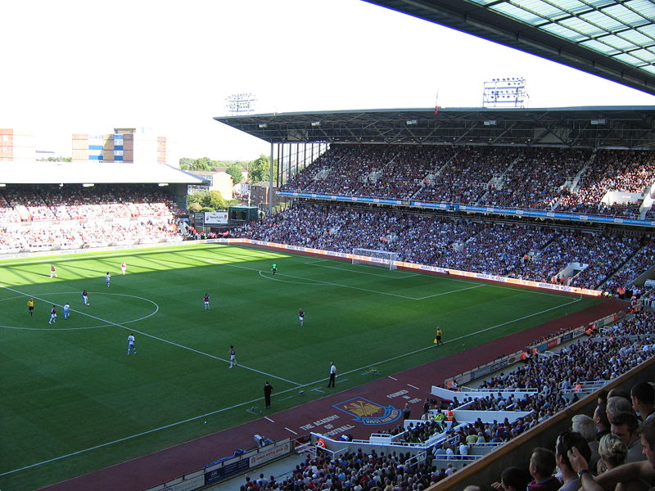
Boleyn Ground
Upton Park, East London, ENGLAND
The home ground of West Ham United

